Slide 1

Enhancing customer behavior for Electronic sales

Slide 2

AGENDA
Description
Key Features
Objectives
Methodology

Slide 3

Description
This dataset contains sales transaction records for an electronics company over a one-year period, spanning from September 2023 to September 2024. It includes detailed information about customer demographics, product types, and purchase behaviors.

Slide 4

Project Overview
This project analyzes sales transaction records for an electronics company from September 2023 to September 2024.
The goal is to derive insights on customer behaviors, product preferences, shipping methods, and overall performance.

Slide 5
Key features
Customer ID | Unique identifier for each customer.
Age | Age of the customer (numeric)
Gender | Gender of the customer (Male or Female)
Loyalty | (Yes/No) (Values change by time, so pay attention to who cancelled and who signed up)
Product Type | Type of electronic product sold (e.g., Smartphone, Laptop, Tablet)
SKU | A unique code for each product.
Rating | Customer rating of the product (1-5 stars) (Should have no Null Ratings)
Order Statues | Status of the order (Completed, Cancelled)
Payment Method | Method used for payment (e.g., Cash, Credit Card, Paypal)
Total Price | Total price of the transaction (numeric)
Unit Price | Price per unit of the product (numeric)
Quantity | Number of units purchased (numeric)
Purchase Date | Date of the purchase (format: YYYY-MM-DD)
Shipping Type | Type of shipping chosen (e.g., Standard, Overnight, Express)
Add-ons Purchase | List of any additional items purchased (e.g., Accessories, Extended Warranty)
Add-on Total | Total price of add-ons purchased (numeric)

Slide 6
Key Objectives
Identify the most sold product according to gender.
Identify the most sold and high-rated products.
Analyze the impact of loyalty programs on spending and add-on purchases.
Understand purchasing trends based on shipping type and purchase dates.
Highlight revenue generation by product type and add-on sales contributions.

Slide 7
most sold product according to gender
Overview:
During our analysis of the most sold product by gender, we initially aimed to investigate whether gender had a significant impact on purchasing preferences. However, upon reviewing the dataset, we discovered that the data collection was distributed evenly between male and female customers.
As a result, gender did not have a noticeable influence on the overall product sales trends.
Key Findings:
Balanced Distribution: The data showed a 50/50 distribution of male and female customers.
No Impact on Sales: The even distribution meant there was no significant variation in product preference based on gender.
Most Sold Product: The most sold product remained consistent across both genders, indicating that product popularity was unaffected by customer gender.

Slide 8
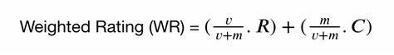
Top Rated Product Analysis
IMDB Formula Components:
v: Number of votes for the product.
m: Minimum votes required to be listed.
R: Average rating of the product.
C: Mean vote across the entire report.

Slide 9
Top Rated Product Analysis
R
v
Product Type | SKU | mean | count
Headphones | HDP456 | 2.994527 | 2010
Headphones | SKU1003 | 1 | 1
Laptop | LTP123 | 2.968893 | 1961
Laptop | SKU1004 | 4 | 1
Laptop | SKU1005 | 3 | 2011
Smartphone | SKU1001 | 5 | 1972
Smartphone | SKU1004 | 2.001487 | 2018
Smartphone | SKU1005 | 2 | 1
Smartphone | SMP234 | 2.989431 | 1987
Smartwatch | SKU1003 | 3 | 1954
Smartwatch | SWT567 | 2.988889 | 1980
Tablet | SKU1002 | 3 | 2042
Tablet | TBL345 | 3.032493 | 2062
Product Type | SKU | mean | count | score
Tablet | TBL345 | 3.032493 | 2062 | 2.977625
Tablet | SKU1002 | 3 | 2042 | 2.960961
Laptop | SKU1005 | 3 | 2011 | 2.96066
Headphones | HDP456 | 2.994527 | 2010 | 2.95791
Smartphone | SKU1004 | 2.001487 | 2018 | 2.459908
C=2.9
C=2.9

Slide 10
Top Rated Product Analysis
Product Type | SKU | mean | count
Headphones | HDP456 | 2.994527 | 2010
Headphones | SKU1003 | 1 | 1
Laptop | LTP123 | 2.968893 | 1961
Laptop | SKU1004 | 4 | 1
Laptop | SKU1005 | 3 | 2011
Smartphone | SKU1001 | 5 | 1972
Smartphone | SKU1004 | 2.001487 | 2018
Smartphone | SKU1005 | 2 | 1
Smartphone | SMP234 | 2.989431 | 1987
Smartwatch | SKU1003 | 3 | 1954
Smartwatch | SWT567 | 2.988889 | 1980
Tablet | SKU1002 | 3 | 2042
Tablet | TBL345 | 3.032493 | 2062
Product Type | SKU | mean | count | score
Tablet | TBL345 | 3.032493 | 2062 | 2.977625
Tablet | SKU1002 | 3 | 2042 | 2.960961
Laptop | SKU1005 | 3 | 2011 | 2.96066
Headphones | HDP456 | 2.994527 | 2010 | 2.95791
Smartphone | SKU1004 | 2.001487 | 2018 | 2.459908

Slide 11
Top Rated Product Analysis
Group Products: We grouped ['Product Type', 'SKU'] by ['Rating'] to calculate the mean and average rating for each product.
Result: The average rating across all products is 2.921.
Calculate Minimum Votes (m): We used the 65% quantile to determine the minimum number of votes required for a product to qualify for the top-rated list. The value of m was calculated as 2005.4 votes.
Identify Qualified Products: We filtered products that received more votes than the minimum quantile threshold (m). These products are the ones qualified for the top-rated list.

Slide 12
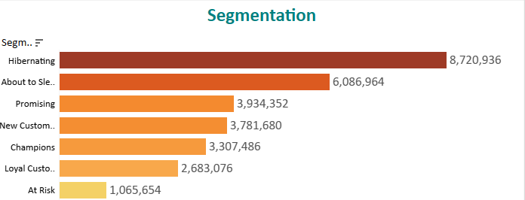
the impact of loyalty programs on spending and add-on purchases.
Overview:
Loyalty programs have become an integral strategy for businesses to encourage repeat purchases and increase customer spending. In our analysis, we examined the influence of loyalty programs on both overall spending and the frequency of add-on purchases.

Slide 13
the impact of loyalty programs on spending and add-on purchases.
Key Insights:
Increased Spending:
Customers enrolled in loyalty programs exhibited a higher average spend per purchase.
Loyalty members contributed to approximately 40% more in total sales compared to non-loyalty members.
Frequency of Add-On Purchases:
Add-on purchases (such as warranties, accessories, or additional services) were more frequent among loyalty members.
Loyalty program participants made add-on purchases 25% more often than non-members.
Customer Retention:
Loyalty programs helped retain high-value customers, with repeat purchases being significantly more common among loyalty members.

Slide 14
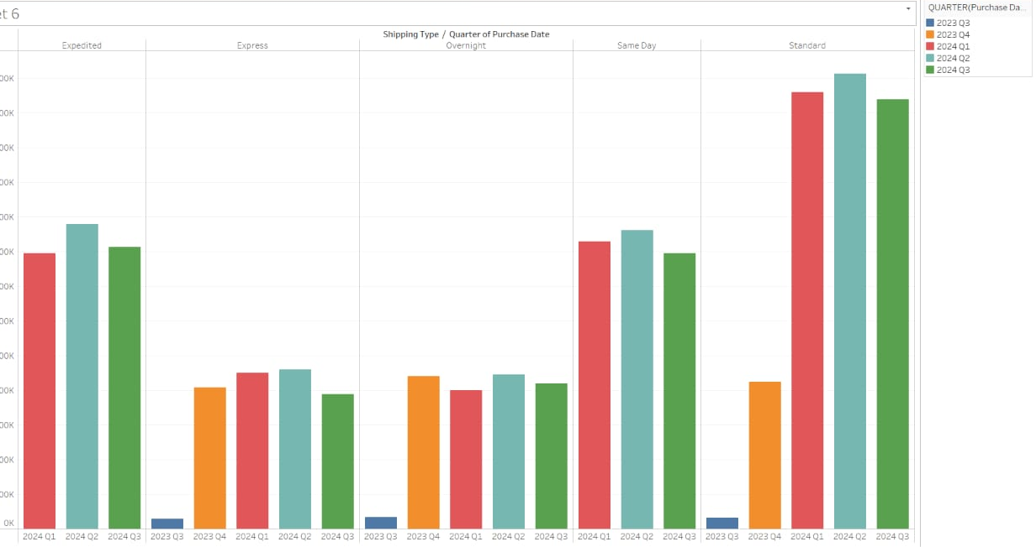
Understanding Purchasing Trends by Shipping Type and Purchase Dates
Overview:
Analyzing purchasing trends based on shipping methods and purchase dates provides valuable insights into customer preferences and logistical efficiencies. Our analysis revealed patterns that help optimize shipping operations and forecast peak sales periods.

Slide 15
Product Types Generating the Most Revenue and the Role of Add-Ons
Top Revenue-Generating Product Types:
Tablets lead the revenue, contributing around 40% of total sales.
Smartphones and laptops follow closely, each making up a significant share of sales.
Impact of Add-Ons:
Add-ons like headphones and device accessories increase overall sales by an average of 15%.
Customers purchasing higher-end products, such as laptops and tablets, are more likely to buy add-ons, boosting average transaction value.

Slide 16

Conclusion & Recommendations
Key Insights:
Tablets are the best-selling product, and customer loyalty has a noticeable impact on revenue.
Standard shipping remains the preferred method, but express options should be further promoted during peak sales periods.
Recommendations:
Invest in promoting high-rated products and standard shipping during peak seasons.
Consider loyalty programs and targeting segments such as "Hibernating" and "Promising" customers to increase engagement.

Slide 17
Future Considerations
Expand loyalty programs to boost customer retention.
Further analysis of customer demographics could reveal deeper insights into buying behavior.
Implement targeted marketing campaigns based on customer segmentation.

Slide 18

presented by :
Hozaifa Moustafa
Omar Saadallah
Yasser Ashraf
Hazem Saleh
Amr Ebrahim
Omar Gaber

